Slide 1
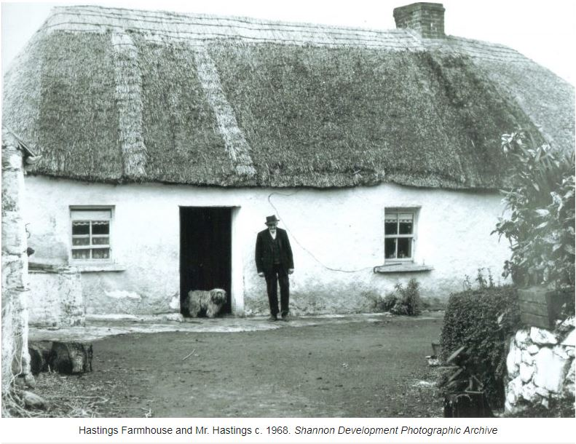
iCAN Network Meeting Shannon co. Clare
4th March 2020

Slide 2
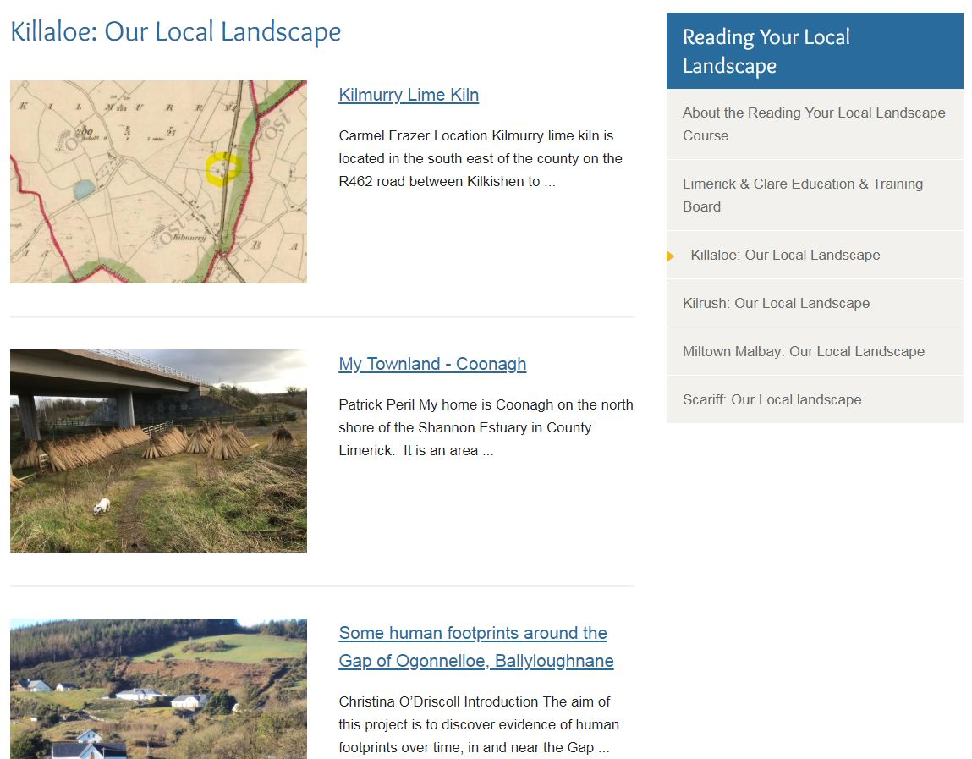
Clarecastle Ballyea Heritage County Clare heritage Office Kilkee heritage: Past & present Roundabout Shannon Scattery island heritage
Reading Your Local landscape
heritage.clareheritage.org
Thank you to all the Galway-based ‘Buddies’ that will be supporting & mentoring the Clare groups as they develop their sites & activities
Clareheritage.org

Slide 3
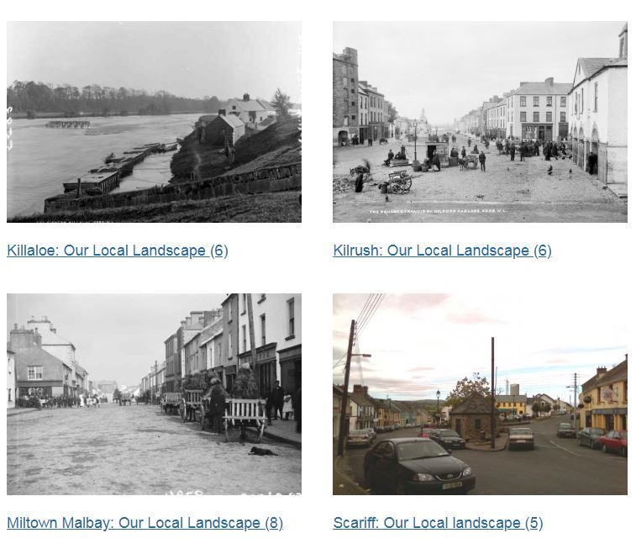
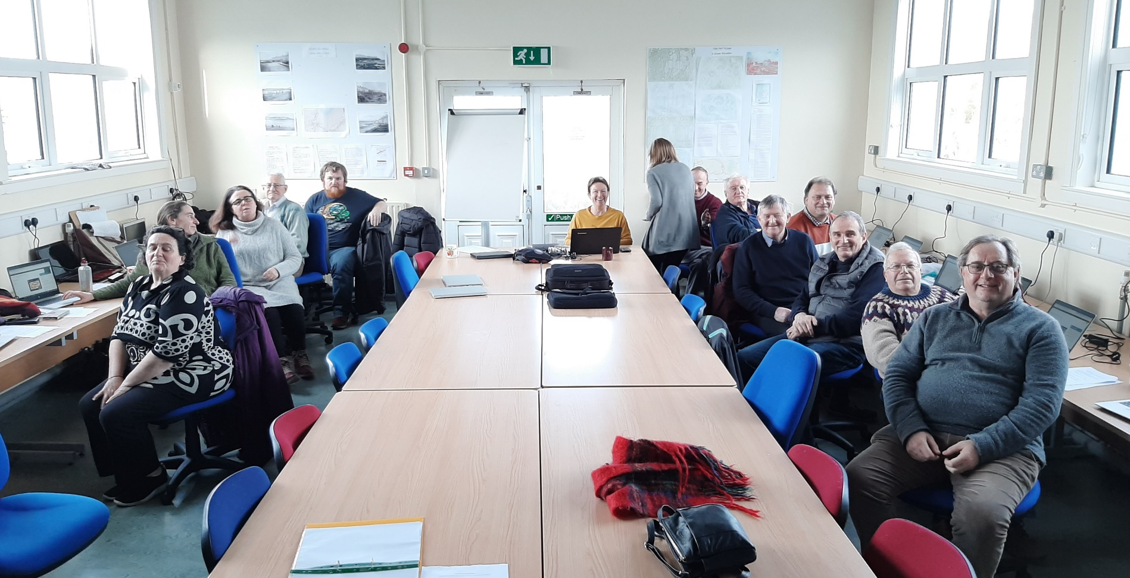
Reading Your Local landscape
heritage.clareheritage.org

Slide 4
County Wicklow
CMS training with Jack Latimer 16/17 January
Groups are currently developing their websites
Meeting Monday 9th March to discuss progress
Meeting with all iCAN groups to be planned for the autumn - location? Ideas?
wicklowheritage.org

Slide 5
Digital Skills training with GK Media
DATE COURSE VENUE TIME
March 11th Video Production (Basic) GK Media, Galway City 11am – 3pm
March 25th Video Production (Advanced)
April 22nd Video Editing (Basic) GK Media, Galway City
April 29th Video Editing (Advanced)
May 6th Social Media (Basic) TBC
May 13th Social Media (Advanced)
June 3rd Audio Editing (Basic) GK Media, Galway City
June 17th Audio Editing (Advanced)

Slide 6
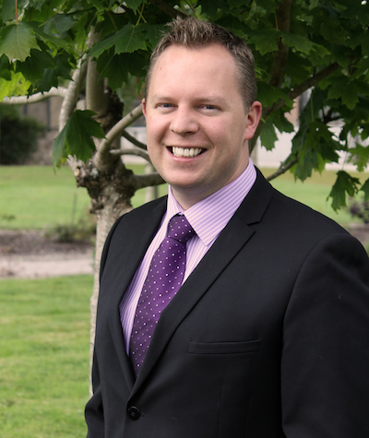
Guest Speaker
Garry has over 20 years experience working as a presenter, producer & tutor in the areas of Film, Television, Radio, and Marketing.
He has produced short films, documentaries, audio-visual instalments, music videos, and a feature film with Screen Ireland (formerly Irish Film Board).
Since 2007, Garry has also worked as a Producer & Presenter in both local and national radio and is Head of Irish Music at Galway Bay FM. He is Fully Qualified with the Teaching Council of Ireland to teach Film & TV Studies and Radio & Sound Production.
ABOUT GARRY
Garry Kelly
GKMedia.ie

Slide 7
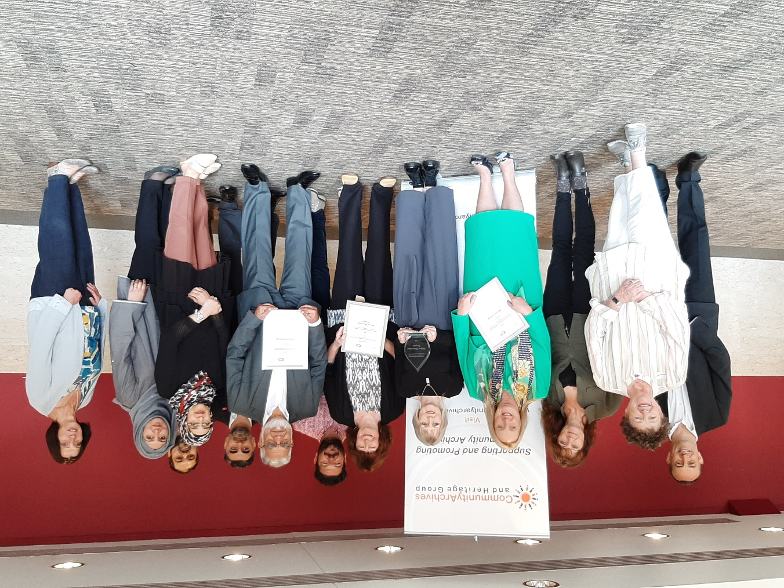
Community Archives & heritage Group (UK& Ireland)& Ireland)
Annual Conference 2020
Location: University College London on 24th June
Theme: Community Archives and Wellbeing: Improving lives and benefiting communities
https://www.communityarchives.org.uk/content/conference/community-archives-and-wellbeing-improving-lives-and-benefiting-communities
Awards Categories:
Community Engagement
Gathering and Preserving Heritage
Contribution to Wellbeing
Networks of Archives
CLOSING DATE FOR ENTRIES: 31 March 2020
2019 CAHG Award Winners, incl. our own Moycullen Heritage!

Slide 8
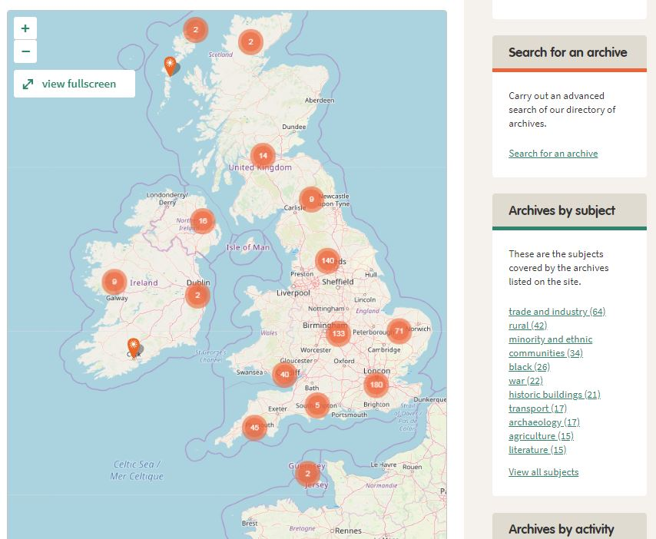
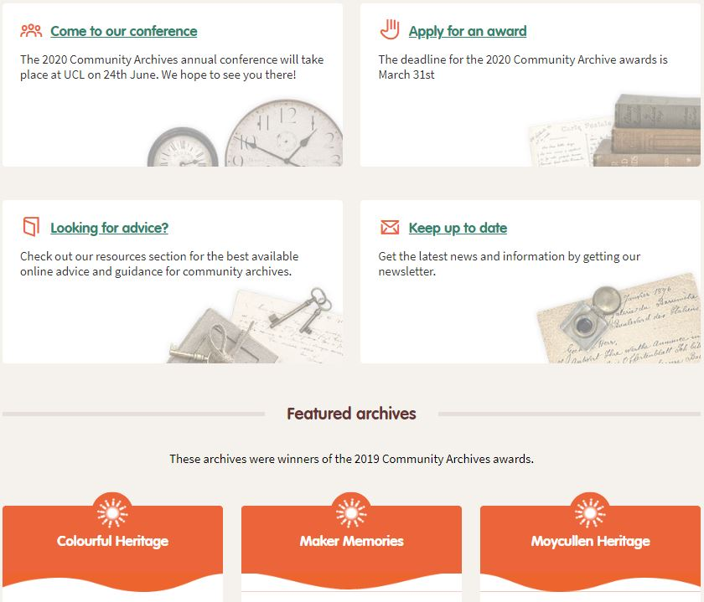
Have you registered your archive?

Slide 9
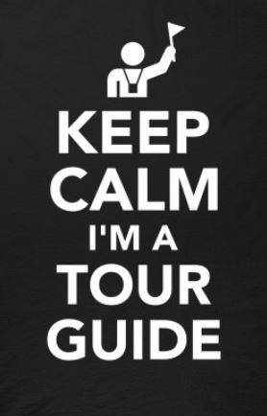
Freelance Tour Guide panel recruitment
National Museum of Ireland – Country Life
Provide tours of exhibitions and museum grounds
Family, adults and formal education groups
Care of resources and teaching aids
Associated general admin work e.g. tour reports & evaluations
Interested? Know someone else?
Submit CV and letter of application
Two referees
Closing date: 19th March 2020
INFORMATION SHEETS AVAILABLE FROM LORNA

Slide 10
The Heritage Council logo – You decide!
The Heritage Council would be delighted for iCAN websites to display their logo
The Heritage Council does not directly contribute project funding, but does:
Contribute toward the cost of employing Heritage Officers
Provides Heritage Officers with resources & funding accessible by communities
Beatrice Kelly, Head of Policy & Research, is a member of iCAN Steering Group, contributing her time and expertise to supporting the project
Logo can be considered a ‘quality mark’ of approval & communicates HC support

Slide 11
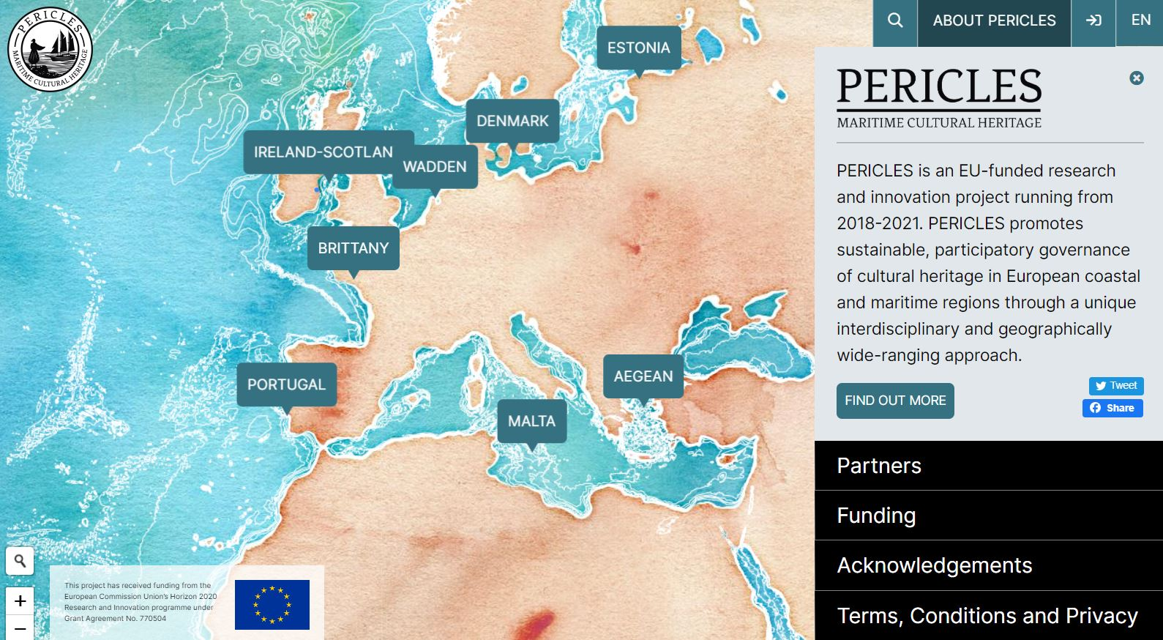
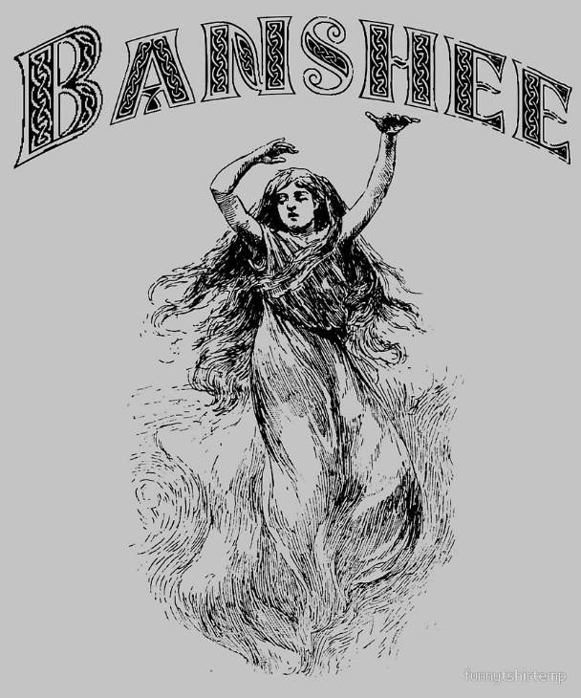
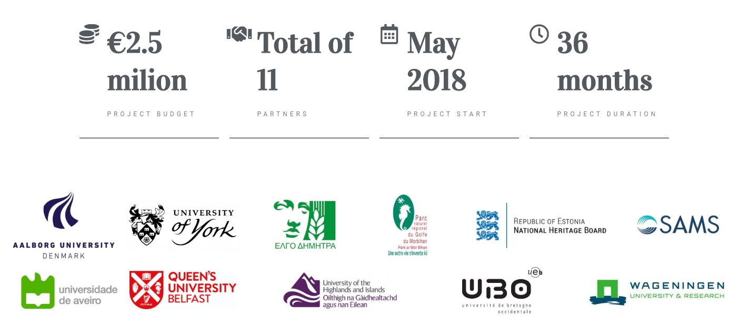
Bits & pieces
https://www.pericles-heritage.eu/
RESEARCH ENQUIRIES:
Magpie folklore
Faeries, Spirits & Mythology

